Slide 1
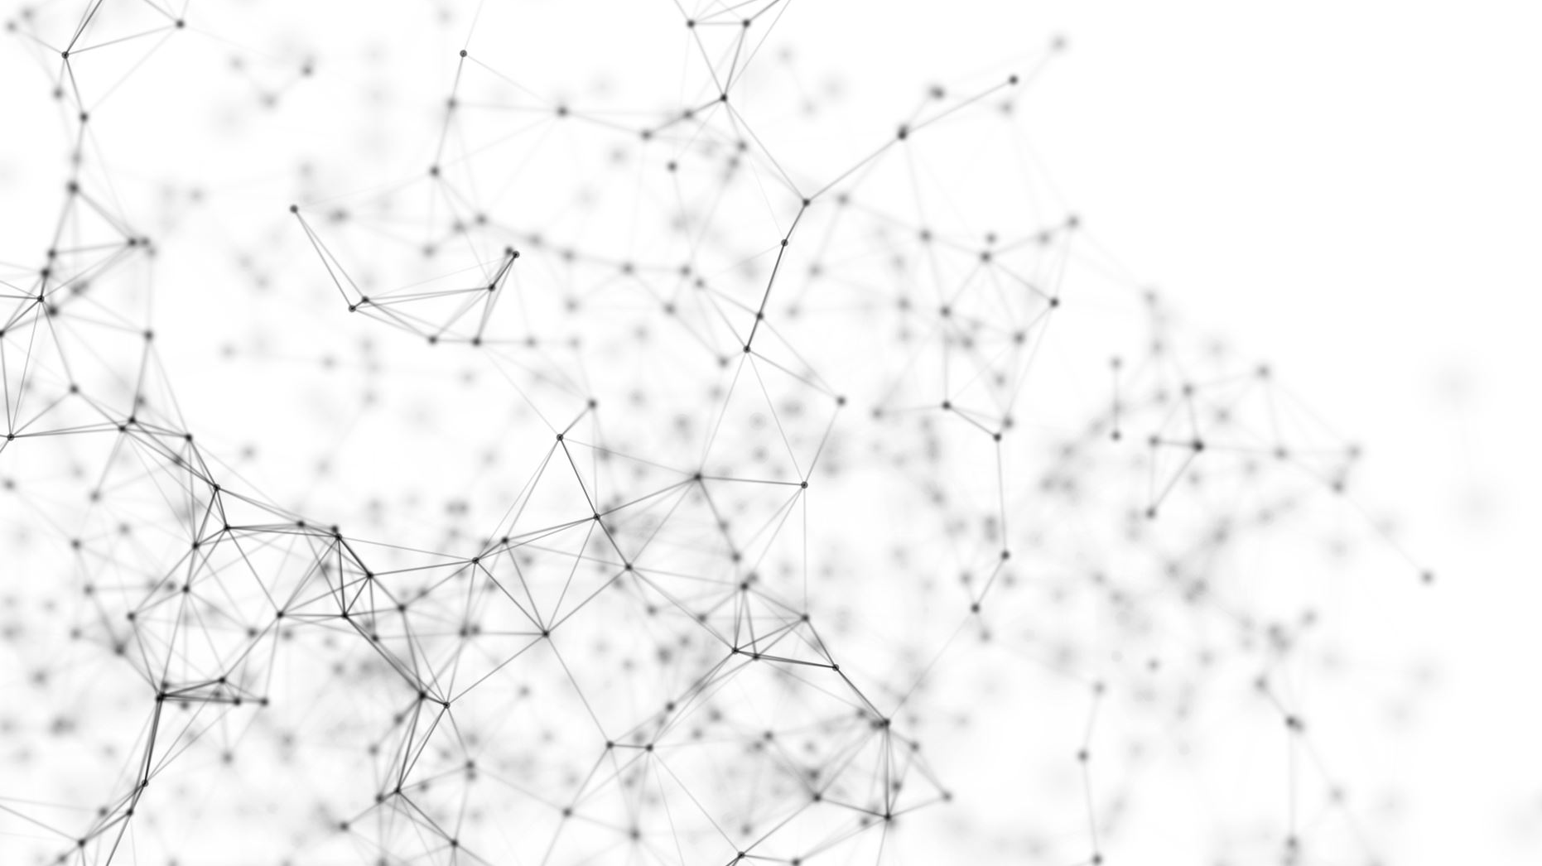
Graph Neighborhood Attentive Pooling
Zekarias Tilahun Kefato
Royal Institute of Technology

Slide 2
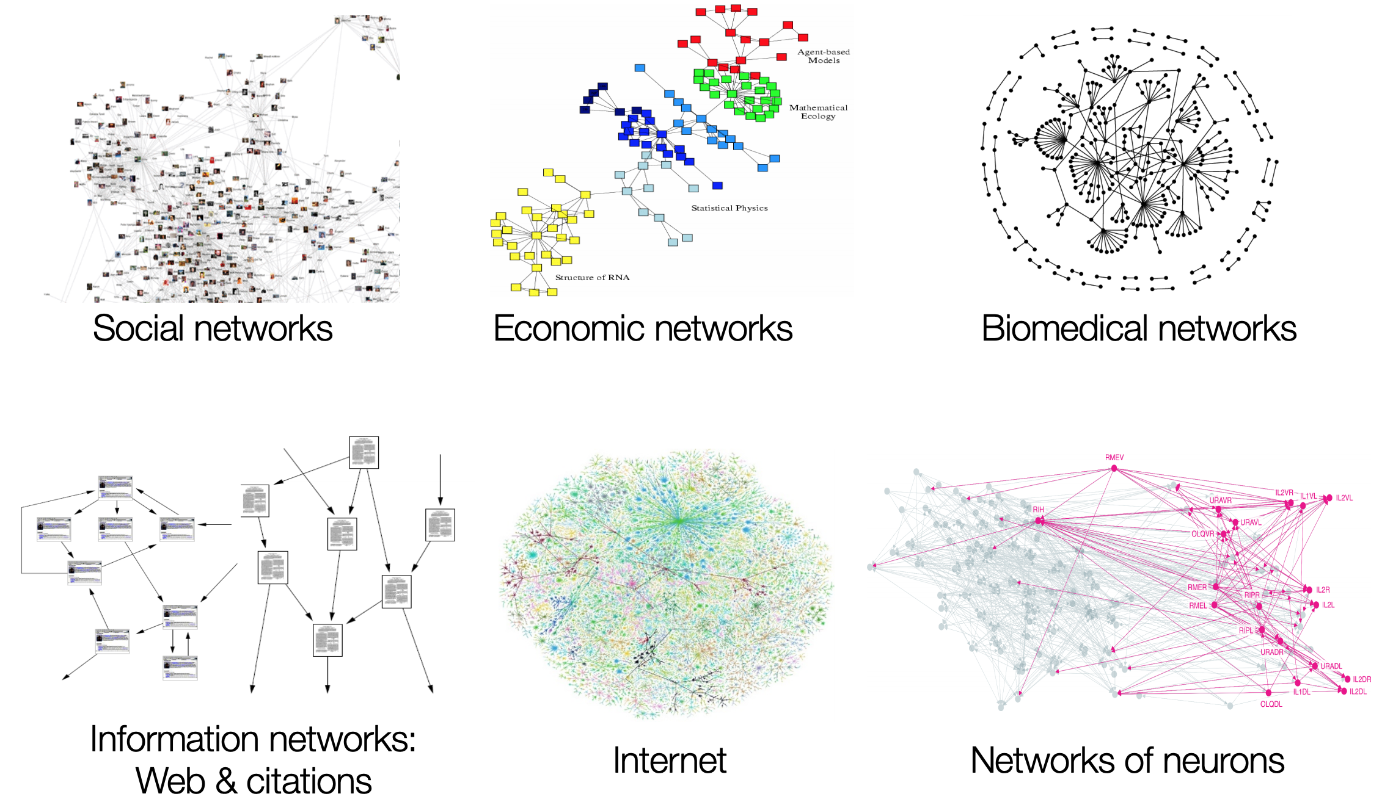
Many Data are Networks/Graphs
Jure Leskovec, Stanford CS224W: Analysis of Networks, http://cs224w.stanford.edu
Notes:
- Massive amount data available in a shape of graphs.
- Social and medical networks (protein.to protein interactions).
Internet and Linked Open Data (RDF (Resource Description framework) link from one point to another)
And citation networks. … a lot of graph input data.

Slide 3
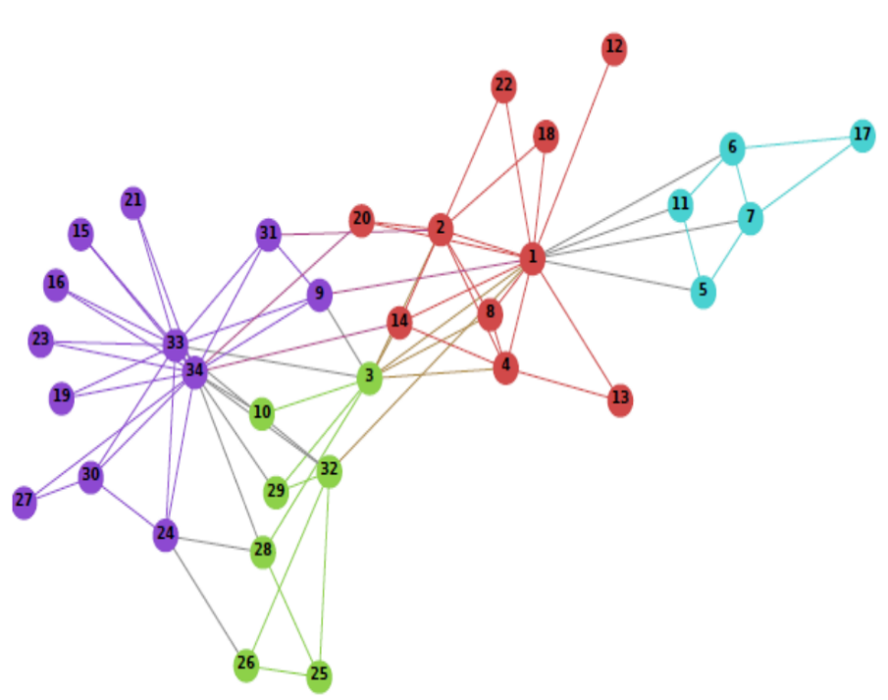

Graph Analytics
Machine
Learning
Models
Notes:
Given graph input data, machine learning algorithms .. get insights.
Sometimes, insights get reflected onto the graph (changing the graph or do tasks related to the graph such as link prediction).
And this is what GRL or NRL is for.

Slide 4
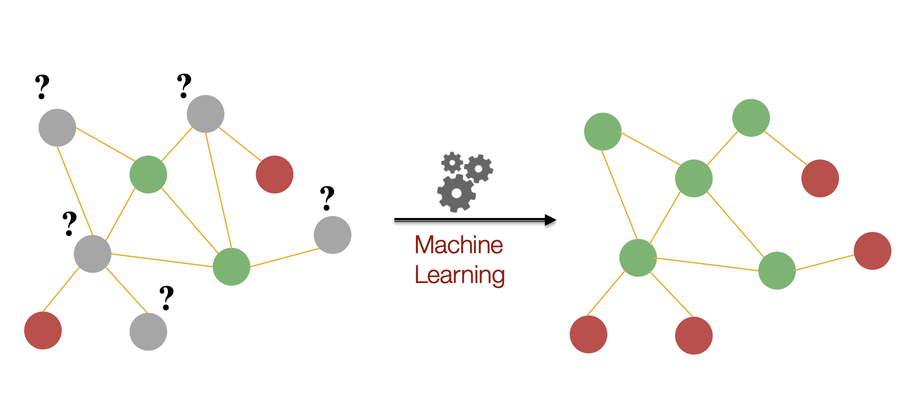
Why NRL?
Node classification
Jure Leskovec, Stanford CS224W: Analysis of Networks, http://cs224w.stanford.edu
Notes:
Classify/or Clarify nodes in a graph, as you can see in the grey nodes according to neighbors or possible communities.

Slide 5
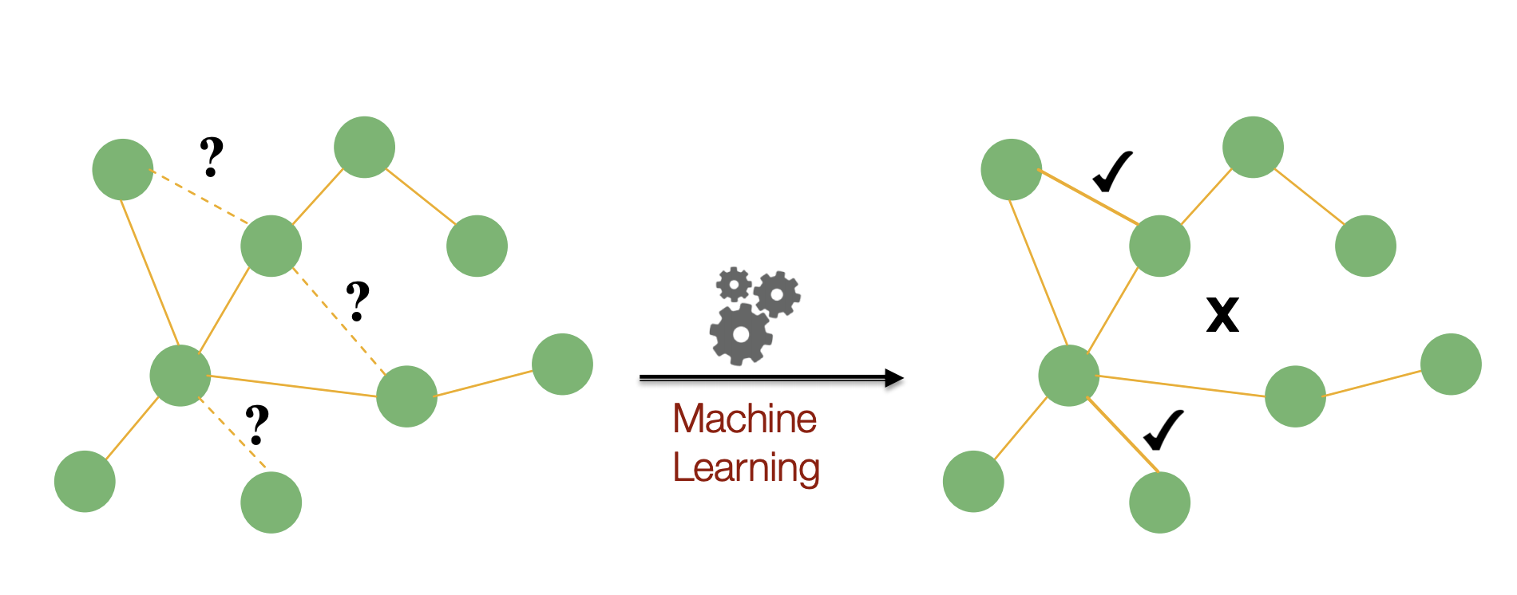
Why NRL?
Link Prediction
Marinka Zitnik and Jure Leskovec, Stanford CS224W: Analysis of Networks, http://cs224w.stanford.edu
Notes:
for link prediction and possible missing links (true or false missings).

Slide 6
Plan
Network Representation Learning (Context-free)
Overview
Network Representation Learning (Context-aware)
Splitter
Graph Neighborhood Attentive Pooling
Notes:
The plan for the rest of the slides is to talk about Context-free or standard NRL and context-aware (Splitter by google and Graph Neigh.. by Zekarias).

Slide 7

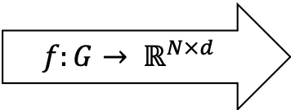
Context-free NRL
$$E= ℝ^{N×d}, d≪N$$
Network Analysis
Link Prediction
Node classification
Clustering
Recommendation
...
$$f:G→ ℝ^{N×d}$$
Apply
Notes:
So what NRL?
Given graph G, you want to learn function f to produce a matrix, whose dimensions are N nodes and d preselected dimensions.
This is matrix is what we call (nodes) embeddings.
Now we have our representations of the nodes of the graph, that can be used in tasks such as …

Slide 8
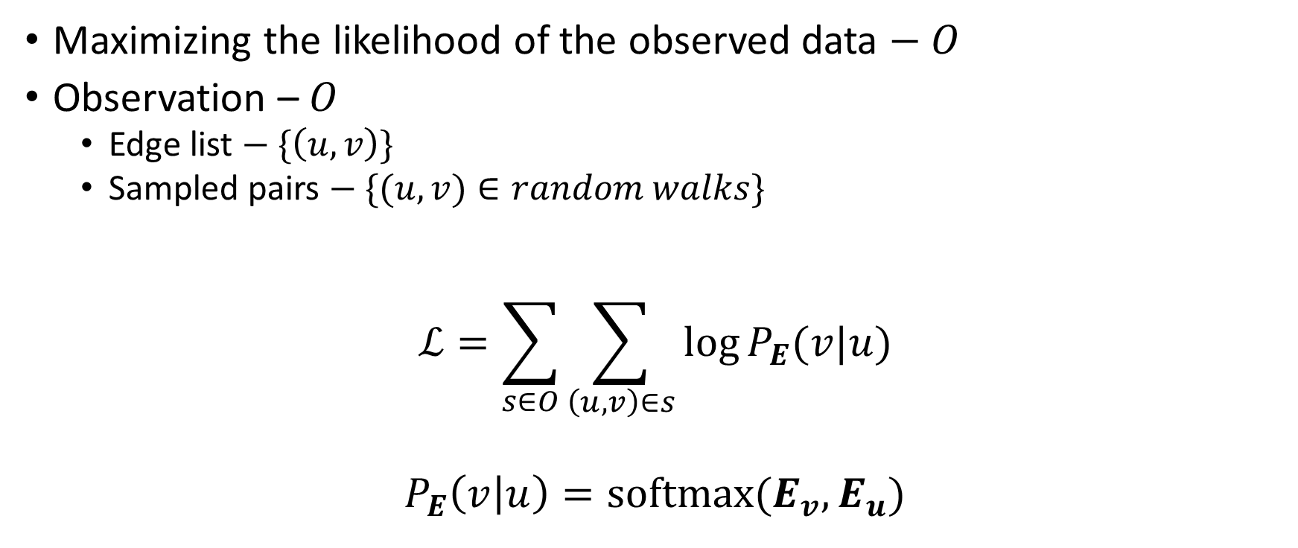
Learning objective
Maximizing the likelihood of the observed data $− O$
Observation – $O$
  Edge list $− \{\left(u, v\right)\}$
  Sampled pairs $− \{(u, v)∈random walks\}$
$$ℒ=\sum_{s∈O}{\sum_{\left(u,v\right)∈s}{\log{P_{E}(v|u)}}}$$
$$P_{E}\left(v | u\right)=\operatorname{softmax}{(E_{v},E_{u})}$$
Notes:
So the objective is to minimize this loss function: basically, the distance between the learnt representations and the observed data.
Where S is typically the number of sampled random walks, and we iterate over the edges in each walk.

Slide 9
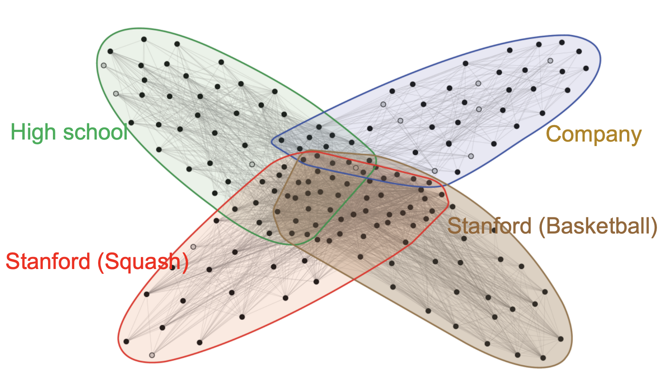
Is a single Embedding enough?
Social Networks, Eg. Twitter
  Users Belong to multiple contexts
    Active user from Stockholm
    Data scientist: follows updates in AI through influencers
    Interested in Global Warming
    Interested in Philosophy
    Has friends in KTH
Jure Leskovec, Stanford CS224W: Analysis of Networks, http://cs224w.stanford.edu
Notes:
However, is a single embedding per nodes enough?
Nodes or let’s say users can have multiple contexts.
Certain active users can have many circles.

Slide 10
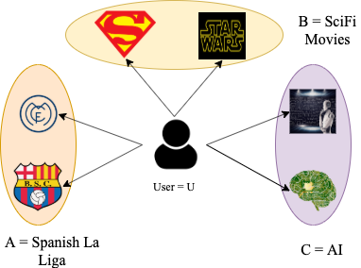
Is a single Embedding enough?
Interaction Networks
Notes:
On the right used can be interested in movies, sports and AI.
On the left, the same drug can be linked with different family of diseases.

Slide 11
Is a single Embedding enough?
Network Analysis
Link Prediction
Node classification
Clustering
Recommendation
...
Sometimes No!
Apply
Notes:
So is a single embedding enough.
We try to learn everything about a node and compress/compact that into one vector.

Slide 12

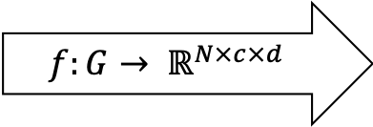
Context-aware NRL
$$E= ℝ^{N×c×d}, c≪d≪N$$
$$f:G→ ℝ^{N×c×d}$$
Network Analysis
Link Prediction
Recommendation
Microscopic Content prediction
Soft Clustering
Apply
Notes:
Now, One change will be about the matrix. Instead of a matrix of nodes times embedding dimension, it will be matrix of nodes times contexts times embedding dimension.
Question: what about the number of contexts? fixed?

Slide 13
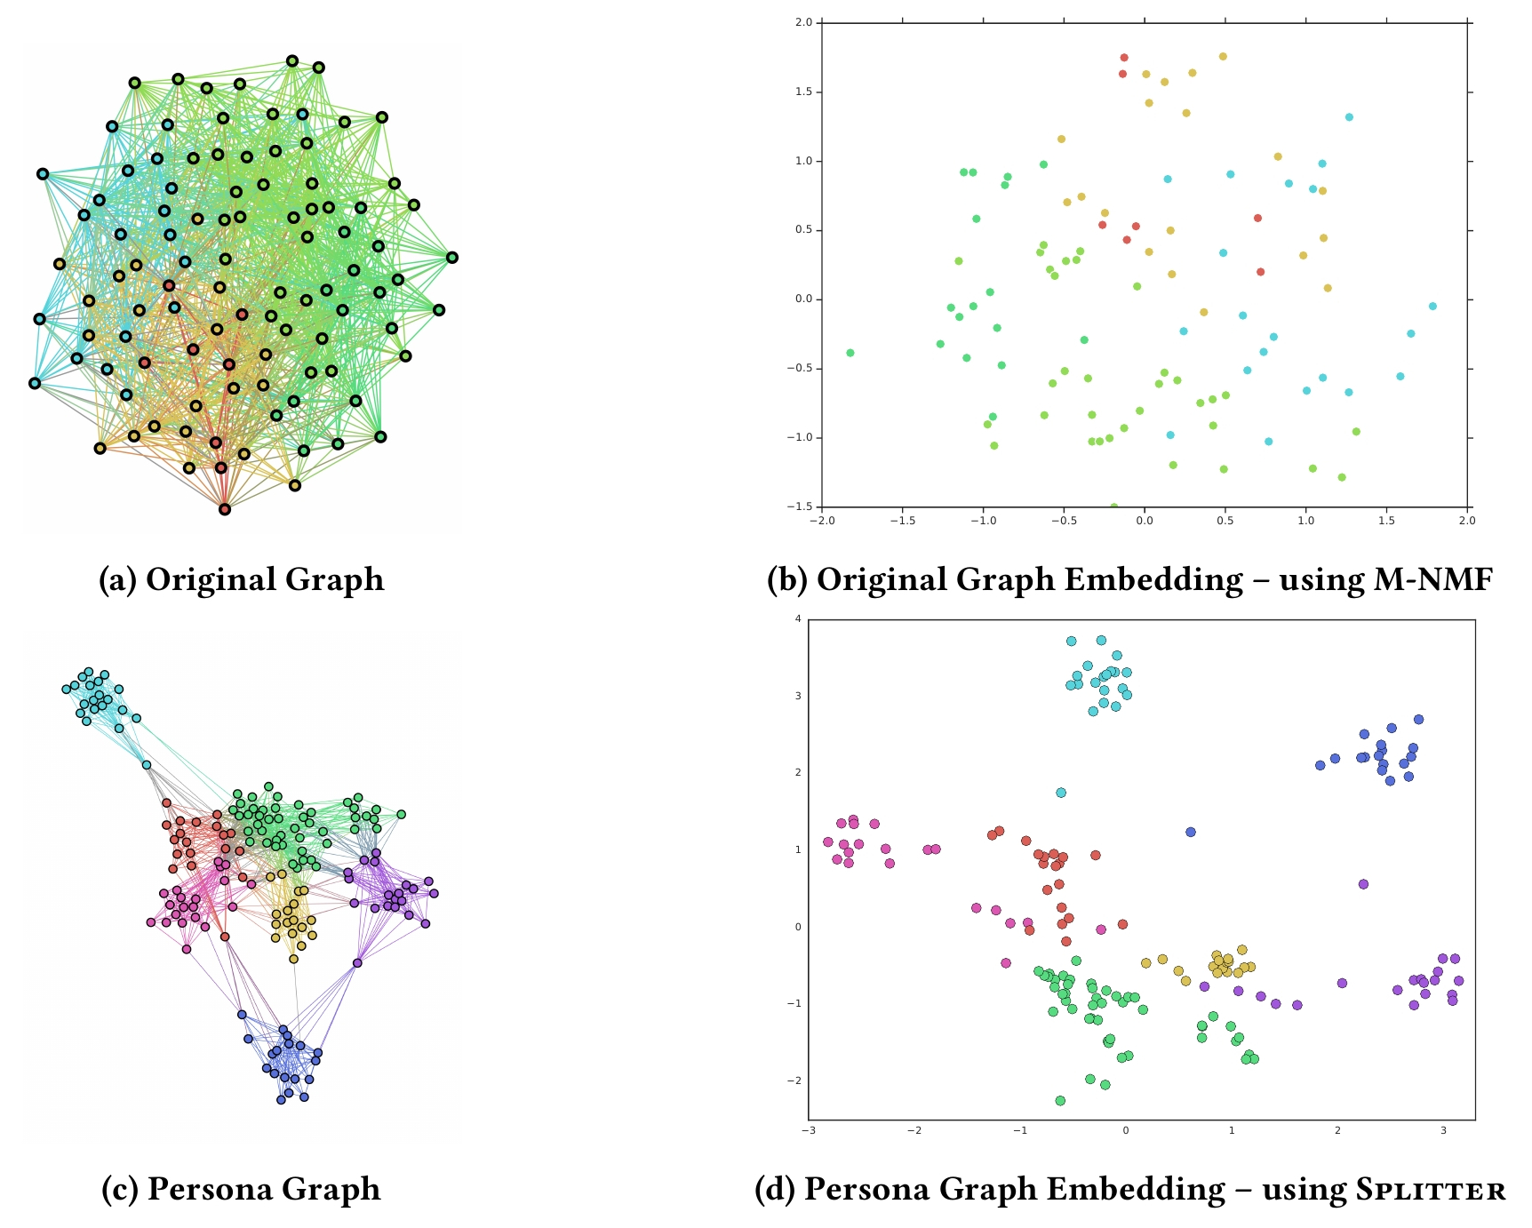
Splitter
100 nodes,
9 highly overlapping cluster
Notes:
Given this graph, the idea is to transform the graph in a way that highlights the different contexts of nodes and wiring similar contexts of different nodes together.
So they end up having that graph. We will talk how in the next slide.
Applying a GRL standard technique on each of these graphs, get you to these embeddings on the right.

Slide 14

Splitter: Graph Transformation
Build Persona Graph $− G_{P}=(V_{P}, E_{P})$
  Extract ego subgraph $G_{Ego}^{u}$, $∀u∈V$:
    $$Ego=u, G_{Ego}^{u}=(N_{u}, E∩N_{u}×N_{u})$$
  Apply community detection (CD) on $G_{Ego}^{u}$
    $$CD\left(G_{Ego}^{u}\right)=\{N_{u}^{1}, …, N_{u}^{t_{u}}\}$$
2
4
1
2
4
1
2
3
5
4
1
1
3
5
3
5

Slide 15

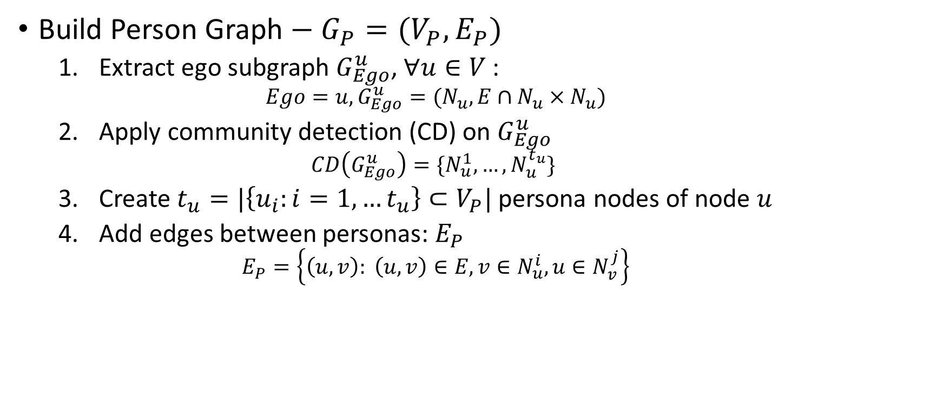





Splitter: Graph Transformation
Build Person Graph $− G_{P}=(V_{P}, E_{P})$
  Extract ego subgraph $G_{Ego}^{u}$, $∀u∈V$:
    $$Ego=u, G_{Ego}^{u}=(N_{u}, E∩N_{u}×N_{u})$$
  Apply community detection (CD) on $G_{Ego}^{u}$
    $$CD\left(G_{Ego}^{u}\right)=\{N_{u}^{1}, …, N_{u}^{t_{u}}\}$$
  Create $t_{u}=|\left\{u_{i}:i=1,…t_{u}\right\}⊂V_{P}|$ persona nodes of node $u$
  Add edges between personas: $E_{P}$
    $$E_{P}=\left\{\left(u, v\right): \left(u, v\right)∈E, v∈N_{u}^{i}, u∈N_{v}^{j}\right\}$$
2
4
$$2_{1}$$
$$4_{1}$$
1
2
4
$$1_{1}$$
2
3
5
4
$$1_{2}$$
1
1
1
3
5
$$3_{1}$$
$$5_{1}$$
3
5
Notes:
You can see why we have the splitter name.

Slide 16
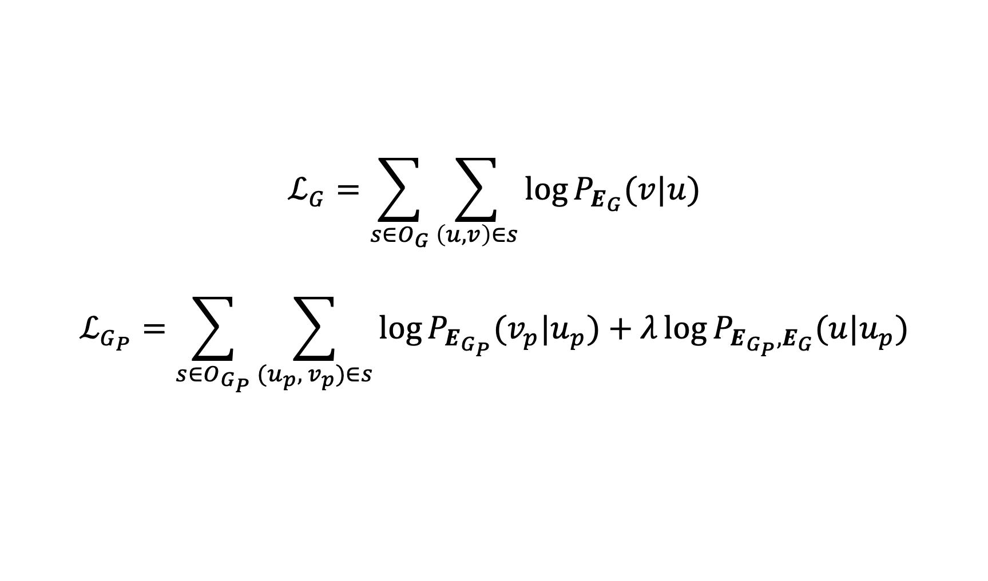
Splitter: Learning
Prior
$$ℒ_{G}=\sum_{s∈O_{G}}{\sum_{\left(u, v\right)∈s}{\log{P_{E_{G}}(v|u)}}}$$
$$ℒ_{G_{P}}=\sum_{s∈O_{G_{P}}}{\sum_{(u_{p}, v_{p})∈s}{\log{P_{E_{G_{P}}}(v_{p}|u_{p})}}}+λ\log{P_{E_{G_{P}},E_{G}}(u|u_{p})}$$
Notes:
Prior that was the loss function.
Now, we have similar loss function on the new transformed graph. But there are two differences.
First, before applying GRL on the new persona graph, nodes embeddings are initialized with the pretrained node embeddings from the original graph.
So we make sure that contexts of the same node start from the same state and the isolated nodes don’t end up with random initialization.
Second the regularization part, they make sure the node embeddings are not far from the original structure, so this is an implementation trick, I would say.

Slide 17
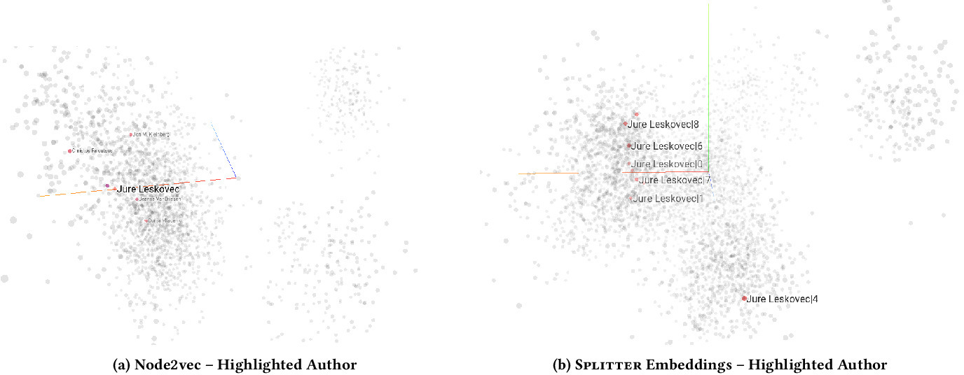
Splitter: Visualization
Notes:
Data mining, Information retrieval AI in two charts.

Slide 18
Graph Neighborhood Attentive Pooling
Splitter
Relies on
Our Goal
Implicitly learn the contexts along with the representation learning?
explicit microscopic community detection
Prior Training
Ego of high degree node could lead to macroscopic community detection
Notes:
Splitter also can find connected components, instead of one connected graph, affects the GRL (Prior training is a problem because local nodes)
So the authors goal is to learn contexts implicitly mainly, rather than modeling it.

Slide 19
Context Learning
Attention Mechanism
Training Input
Attended
Do not Attend
2
4
2
4
2
4
1
1
1
3
5
3
5
3
5
2
4
2
4
1
1
3
5
3
5
Notes:
Who is not familiar with that, you focus model on the relevant features during learning.
Pay attention to its neighbors as contexts.
That’s equivalent to the explicit approach of context from splitter.

Slide 20

Neighborhood as feature
${N_{u}= Sample(N}_{u}, s)$, ${N∈}^{|V|×s}$
  $$N_{1}=[2, 3, 4, 5]$$
  $$N_{2}=[1, 3, 0, 0]$$
  $$N_{3}=[1, 2, 0, 0]$$
  $$N_{4}=\left[1, 5, 0, 0\right]$$
  $$N_{5}=[1, 4, 0, 0]$$
2
4
1
3
5
Notes:
Neighborhood features size is pre-selected, so we don’t …
So how to choose what to pay attention for, is from the neighborhood features.
Ex. The intersection of N1 and N2.

Slide 21

Algorithm: Attentive Pooling Network (APN)
Q&A Ranking
Input
  Question $q=[w_{i}:i=1,…, m]$
  Set of candidate answers $\left\{a_{k}=\left[w_{j}:j=1…n\right]\right\}$
Learn $Rank\left(q, a_{k}\right)∈[0, 1]$
Notes:
That algorithm is based on the algorithm in Information retrieval Question Answering task.
Question is a vector of words, and set of answers as matrix, and you need to calculate the score of each answer relative to the question.

Slide 22

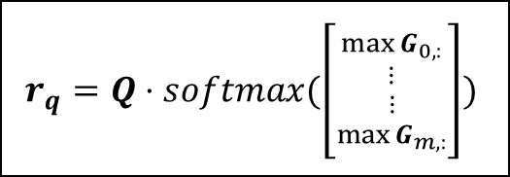



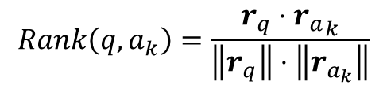








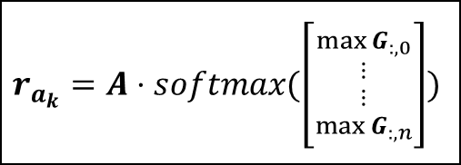
APN Architecture
$$q=[w_{1},…, w_{m}]$$
$$a_{k}=[w_{1},…, w_{n}]$$
$$E_{q}={\left[w_{1},…,w_{m}\right]}^{d×m}$$
$$E_{a_{k}}={\left[w_{1},…,w_{n}\right]}^{d×n}$$
$$CNN/BILSTM$$
$$CNN/BILSTM$$
$$Q∈ℝ^{d×m}$$
$$U∈ℝ^{d×d}$$
$$A∈ℝ^{d×n}$$
$$G=\tanh\left(Q^{T}UA\right)∈ℝ^{m×n}$$
$$Column wise pooling$$
$$Row wise pooling$$
$$r_{q}=Q⋅softmax(\left[{{\max{G_{0,:}} \atop ⋮} \atop {⋮ \atop \max{G_{m,:}}}}\right])$$
$$r_{a_{k}}=A⋅softmax(\left[{{\max{G_{:,0}} \atop ⋮} \atop {⋮ \atop \max{G_{:,n}}}}\right])$$
$$Rank\left(q, a_{k}\right)=\frac{r_{q}⋅{r_{a}}_{k}}{\left\|r_{q}\right\|⋅\left\|r_{a_{k}}\right\|}$$
Notes:
LSTM output for who knows, would be a matrix of d the size of hidden unit, times the size of the voca (the rows of the embeddings).
Weight interaction so one of them is a weight for the other, and you can give up the U matrix for that matter.
Q question matrix, A answer matrix
U for more degree of freedom and expressive modeling.
G m times n. the rows corresponds to the words of the question and the columns correspond to words in the answer.
Column wise is like normalizing the words in the question by their significance to the answer. So you pay attention to the important words of the question.
Same for row wise for answers. Then calculate the cosine similarity between the representation to maximize that.

Slide 23

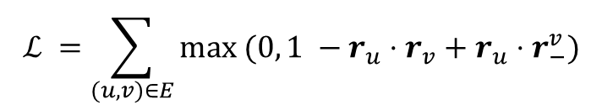






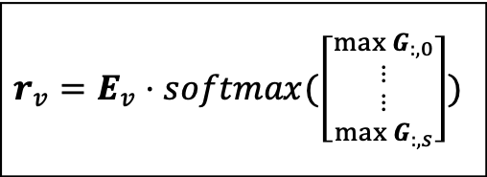

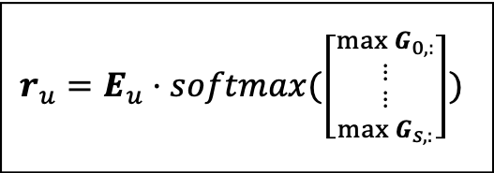
Our Architecture
$$N_{u}=[u_{1},…,u_{s}]$$
$$N_{v}=[v_{1}, …, v_{s}]$$
$$E_{u}={\left[u_{1},…, u_{s}\right]∈ℝ}^{d×s}$$
$$U∈ℝ^{d×d}$$
$$E_{v}={\left[v_{i},…, v_{s}\right]∈ℝ}^{d×s}$$
$$G=\tanh\left(E_{u}^{T}UE_{v}\right)∈ℝ^{s×s}$$
$$Column wise pooling$$
$$Row wise pooling$$
$$r_{u}=E_{u}⋅softmax(\left[{{\max{G_{0,:}} \atop ⋮} \atop {⋮ \atop \max{G_{s,:}}}}\right])$$
$$r_{v}=E_{v}⋅softmax(\left[{{\max{G_{:,0}} \atop ⋮} \atop {⋮ \atop \max{G_{:,s}}}}\right])$$
$$ℒ =\sum_{(u, v)∈E}{max (0, 1 −r_{u}⋅r_{v}+r_{u}⋅r_{−}^{v})}$$
Notes:
The same approach applied here, were words are nodes and the co-occurrences are the edges. So given edge u and v, the neighborhood features. Algorithm becomes attentive to the common neighbours.
Two differences are
- The author gave up the deep learning layers, for the order doesn’t matter in those graphs.
- loss function is a hinge loss function.

Slide 24
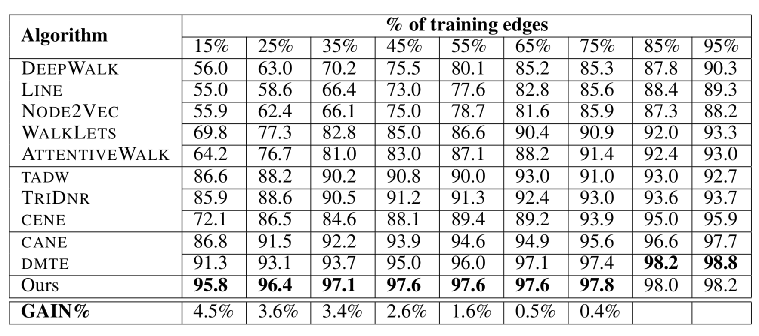
Some Results: Link Prediction
AUC Score for Cora Dataset

Slide 25
Conclusion
Explore the data
Are there contexts?
Do they overlap?
Do the contexts influence the problem under consideration?
This could be a signal for context-aware learning

Slide 26
Thank you!

Slide 27
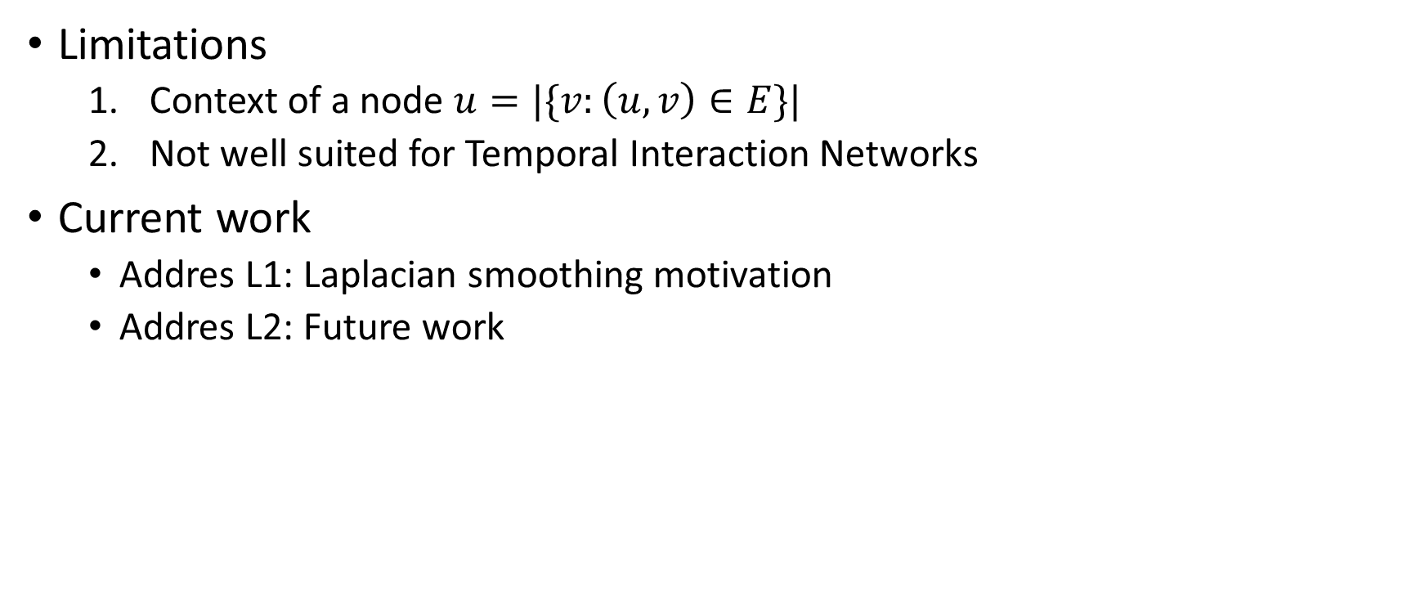
Work in progress
Limitations
  Context of a node $u=|\{v:\left(u, v\right)∈E\}|$
  Not well suited for Temporal Interaction Networks
Current work
  Addres L1: Laplacian smoothing motivation
  Addres L2: Future work

Slide 28
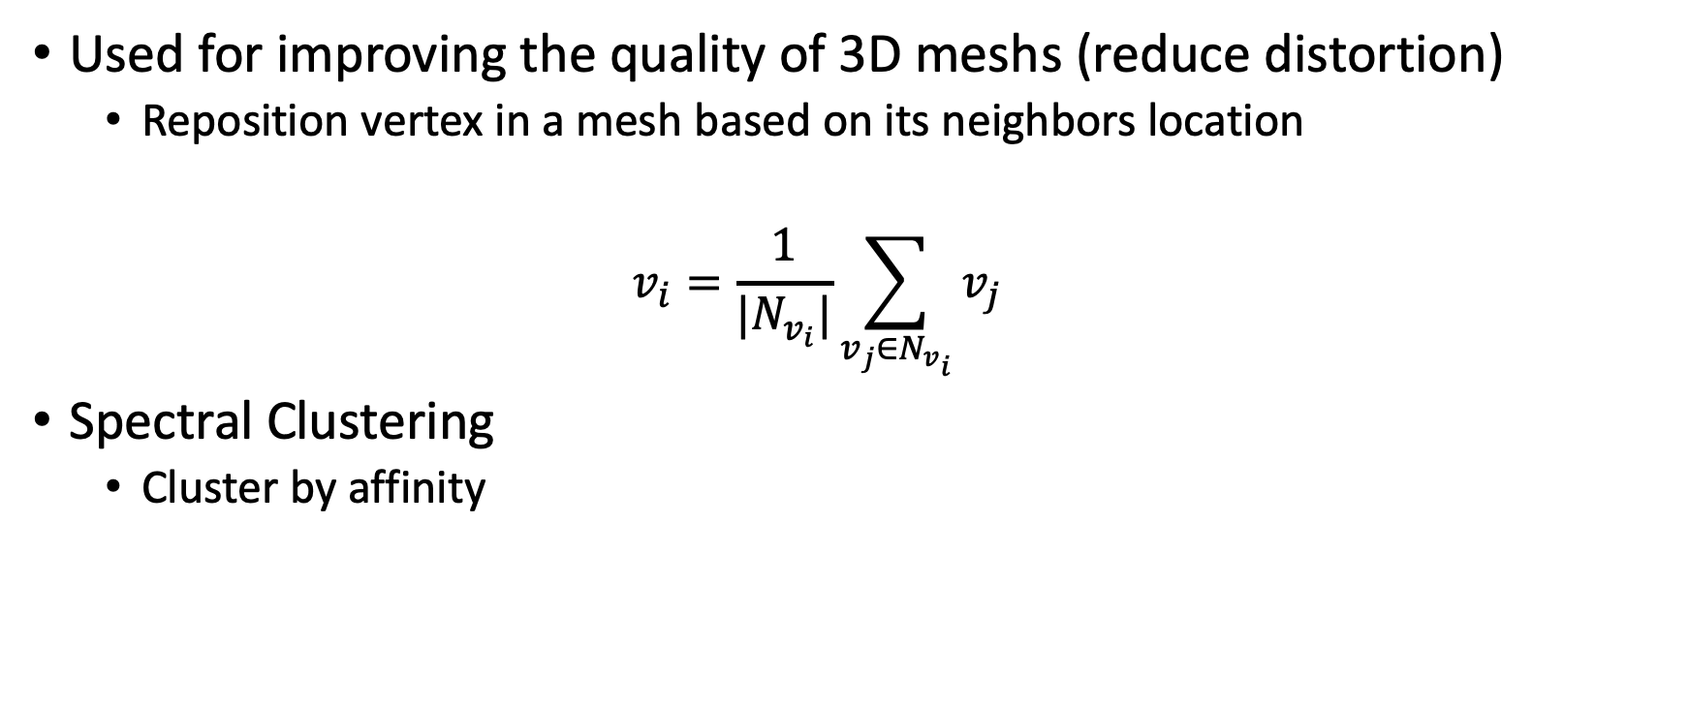
Laplacian smoothing
Used for improving the quality of 3D meshs (reduce distortion)
  Reposition vertex in a mesh based on its neighbors location
  $$v_{i}=\frac{1}{|N_{v_{i}}|}\sum_{v_{j}∈N_{v_{i}}}{v_{j}}$$
Spectral Clustering
  Cluster by affinity

Slide 29













Similar Idea
$$ℛ$$
$$𝒾$$
$$α$$
B
$$2$$
$$8$$
$$5$$
$$1$$
$$4$$
$$9$$
$$3$$
$$0$$
$$7$$
$$6$$

Slide 30
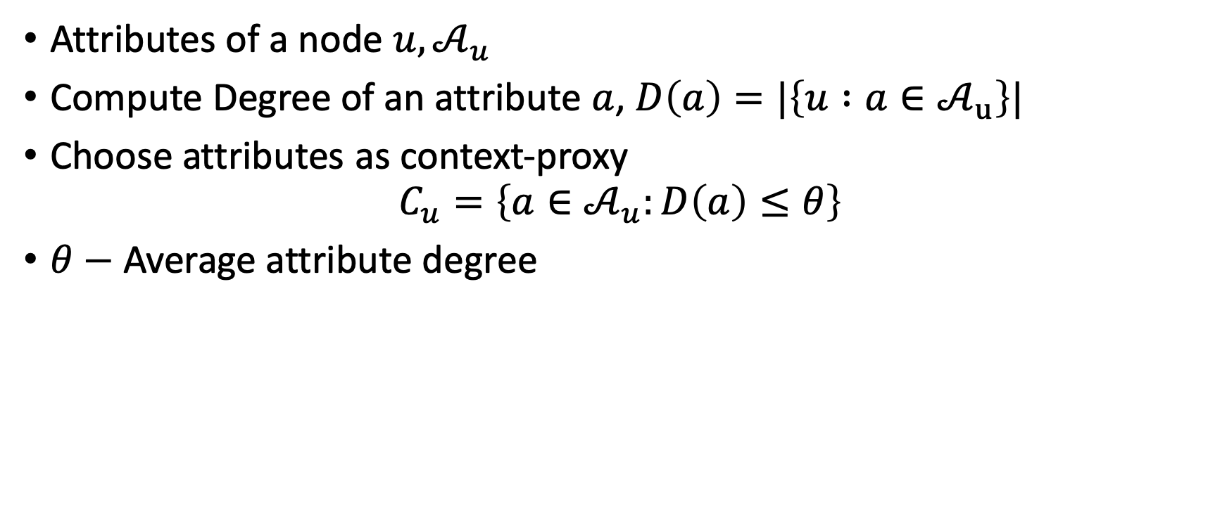
Smoothing Heuristic
Attributes of a node $u,𝒜_{u}$
Compute Degree of an attribute $a$, $D\left(a\right)=|\left\{u :a∈𝒜_{u}\right\}|$
Choose attributes as context-proxy
$$C_{u}=\left\{a∈𝒜_{u}:D\left(a\right)≤θ\right\}$$
$θ−$ Average attribute degree

Slide 31























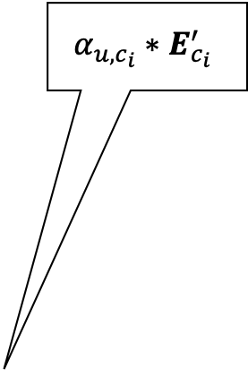





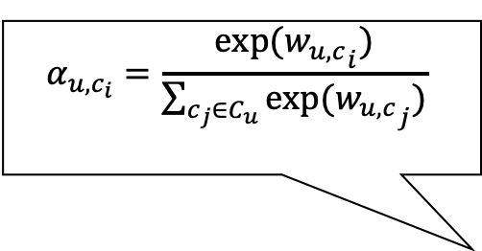
Proposed Architecture: Self Attention
$$Input: (u, \left[c_{1},…, c_{\left|C_{u}\right|}\right])$$
$$u$$
$$E_{u}^{g}$$
$$c_{1}$$
$${E_{c}^{g}}_{1}$$
$$Atn$$
$${E_{c}^{u}}_{1}$$
$$c_{2}$$
$${E_{c}^{g}}_{2}$$
$$Atn$$
$${E_{c}^{u}}_{2}$$
$$c_{3}$$
$${E_{c}^{g}}_{3}$$
$$Atn$$
$${E_{c}^{u}}_{3}$$
$$⋮$$
$$⋮$$
$$c_{|C_{u}|}$$
$${E_{c}^{g}}_{|C_{u}|}$$
$$Atn$$
$${E_{c}^{u}}_{|C_{u}|}$$
$$α_{u,c_{i}}=\frac{exp⁡({w_{u,c}}_{i})}{\sum_{c_{j}∈C_{u}}{exp⁡({w_{u,c}}_{j})}}$$
$$α_{u,c_{i}}∗E_{c_{i}}^{′}$$
$Atn$
$$w_{u,c_{i}}$$
$$σ$$
$$E_{u}^{g}$$
$$E_{c}^{′}$$
$$E_{c_{i}}^{u}$$
$$E_{c_{i}}^{g}$$

Slide 32
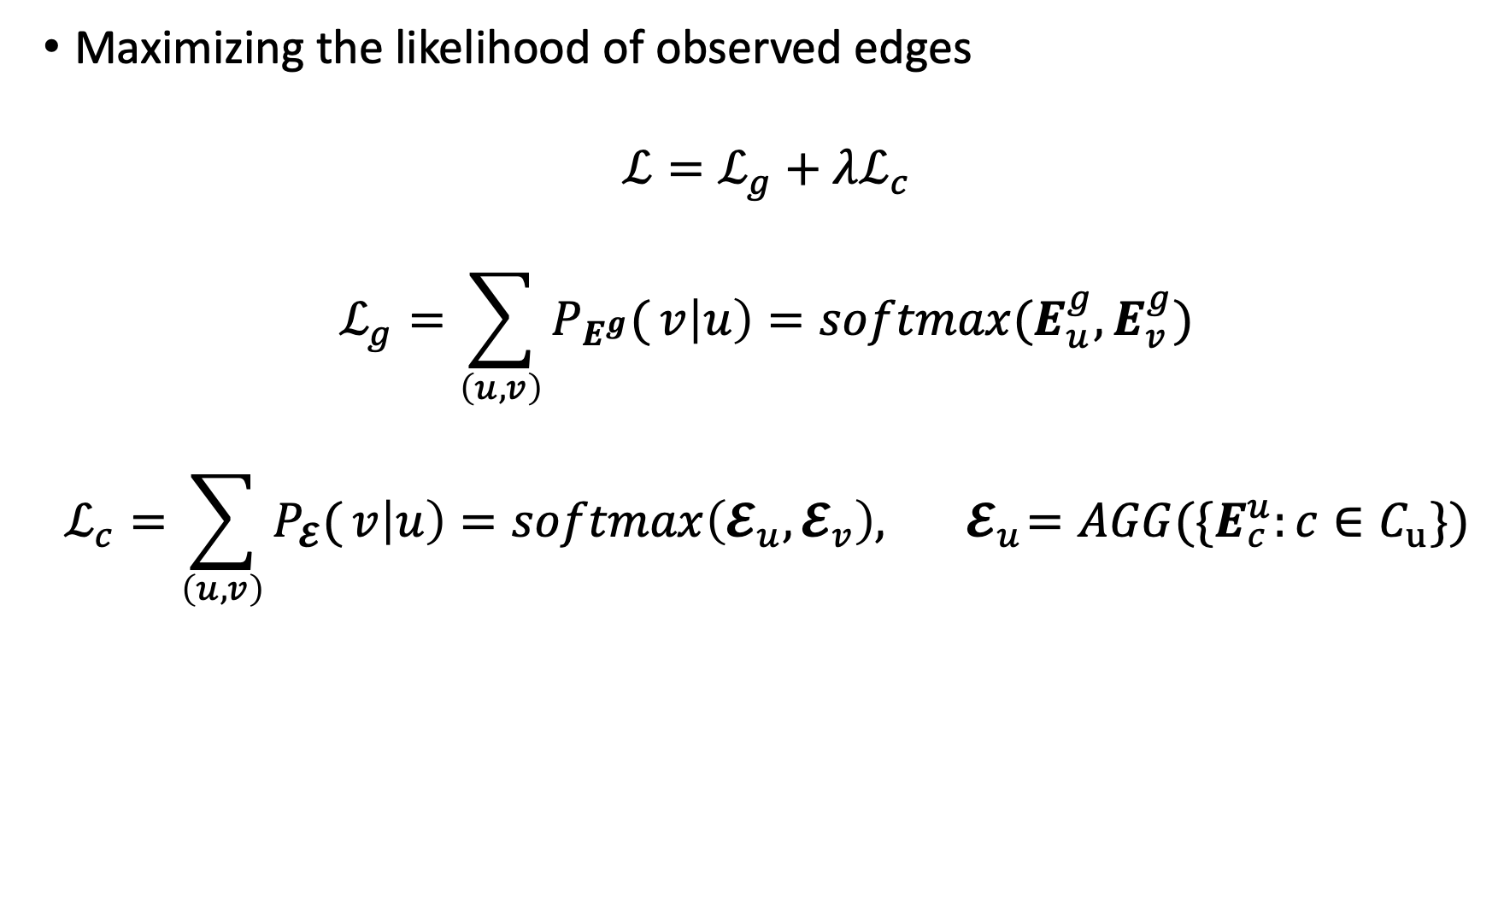
Learning
Maximizing the likelihood of observed edges
$$ℒ=ℒ_{g}+λℒ_{c}$$
$$ℒ_{g}=\sum_{\left(u, v\right)}{P_{E^{g}}(}v\left|u\right)=softmax(E_{u}^{g},E_{v}^{g})$$
$$ℒ_{c}=\sum_{\left(u, v\right)}{P_{𝓔}(}v\left|u\right)=softmax\left(𝓔_{u},𝓔_{v}\right), { 𝓔}_{u}=AGG({\{E}_{c}^{u}:c∈C_{u}\})$$

Slide 33
Conclusion
Explore the data
Are there contexts?
Do they overlap?
Do the contexts influence the problem under consideration?
This could be a signal for context-aware learning

Slide 34
Thank you!

Slide 35
Backup slides

Slide 36



















Smoothing via Sparse self attention
$$u$$
$$E_{u}^{g}$$
$$a_{1}$$
$${E_{a}^{g}}_{1}$$
$$Atn$$
$${E_{a}^{c}}_{1}$$
$$a_{2}$$
$${E_{a}^{g}}_{2}$$
$$Atn$$
$${E_{a}^{c}}_{2}$$
$$a_{3}$$
$${E_{a}^{g}}_{3}$$
$$Atn$$
$${E_{a}^{c}}_{3}$$
$$⋮$$
$$⋮$$
$$a_{|𝒜_{u}|}$$
$${E_{a}^{g}}_{|𝒜_{u}|}$$
$$Atn$$
$${E_{a}^{c}}_{|\hat{𝒜_{u}}|}$$

Slide 37
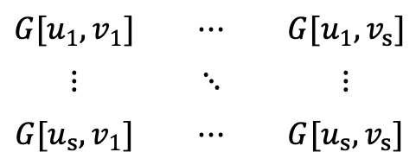




Interpretability
Input pairs $N_{u}=\left[u_{1},…, u_{s}\right], N_{v}=[v_{1}, …, v_{s}]$
Soft alignment (affinity) matri $G$
$$G[u_{1},v_{1}]$$ | $$⋯$$ | $$G[u_{1},v_{s}]$$
$$⋮$$ | $$⋱$$ | $$⋮$$
$$G[u_{s},v_{1}]$$ | $$⋯$$ | $$G[u_{s},v_{s}]$$
$$G=$$
$${{\max{G_{u_{1},:}} \atop ⋮} \atop {⋮ \atop \max{G_{u_{s},:}}}}$$
$${{\max{G_{:,v_{1}}} \atop ⋮} \atop {⋮ \atop \max{G_{:,v_{s}}}}}$$
Inspect indices corresponding leading to max

Slide 38
Some Results: Link Prediction
AUC Score for Cora Dataset

Slide 39
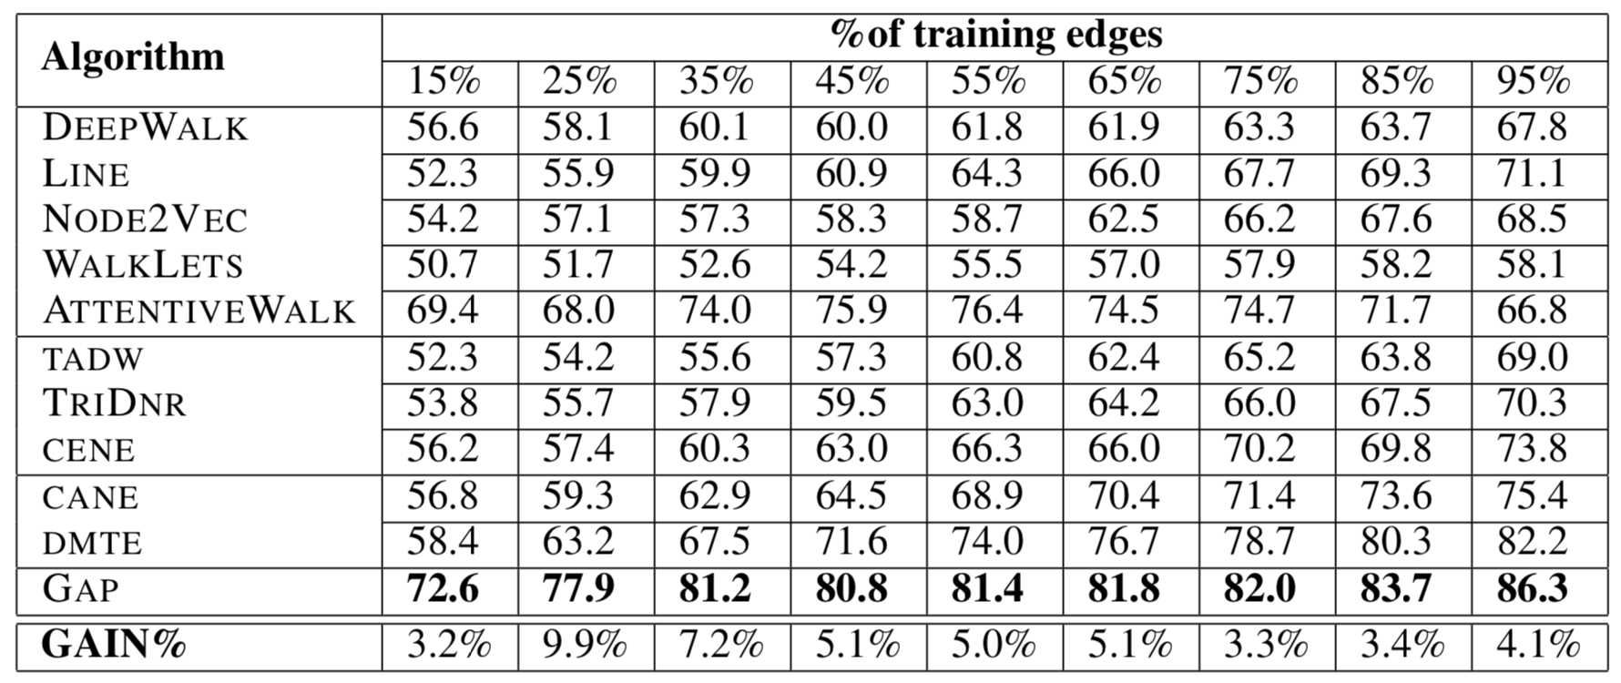
Some Results: Link Prediction
AUC Score for Zhihu Dataset

Slide 40
Current Work-2:

